Slide 1
Domain : Deep Learning Technology : Python
Rasa college Chat Bot

Slide 2
ABSTRACT
The growth of technologies like Artificial Intelligence (AI), Big Data & Internet of Things (IoT), etc. has marked many advancements in the technological world since the last decade. These technologies have a wide range of applications. One such application is “Chatterbot or “Chatbot”. Chatbots are conversational AIs, which mimics the human while conversing & eliminates the need of human by automating mundane tasks. In the study undertaken, we have created a chatbot in education domain & it is named as “College Chatbot”, This chatbot is a web-based application that analyses and understands user's queries and provides an instant and accurate response. Rasa technology is used to construct this chatbot. It's an open-source technology, which uses its two main packages i.e., Rasa Core & Rasa Natural Language Understanding (NLU) in order to build a Contextual AI Chatbot.

Slide 3
NLU is used to infer the intent and to extract the necessary entities from user input & the Rasa Core provides the output by building a probabilistic model with the help of Recurrent Neural Network (RNN). Evaluation of the model is done by getting a confusion matrix and performance measures like Precision, Accuracy & F1 Score which come out to be 0.628, 0.725 and 0.669 respectively on average basis. This chatbot's accuracy, lack of dependability on human resources, 24 x 7 accessibility and low maintenance creates various opportunities for its implementation. This conversational agent can not only be used in educational institutions but also in places where enquiry becomes a tedious task.

Slide 4
Introduction
These days, we see the talk bots wherever Chatbots are the wellspring of answers to the client's inquiries in a specific space where it is working. Visit bots are the wellspring of answers to the client's inquiries. The requirement for school request framework emerges because of different reasons which include: the moderate idea of school site, an outcast would not realize where to look for a specific snippet of data, hard for the individual external school's area to remove data. The school enquiry framework will give the reaction by summing up the question and afterward yield answers, it additionally gives particular data what the client needs. Rasa is an open-source system for building AI bots which comprise of two parts: Rasa NLU and Rasa center.

Slide 5
Rasa center is the segment which handles the exchange motor for the system and helps in making more unpredictable chatbots with customization. Rasa's NLU assists the engineers with the innovation and the apparatuses essential for catching and understanding client input, deciding the purpose and substances.

Slide 6
LITERATURE REVIEW
S. NO | Authors | Title | Outcomes
1 | AMANDA STRIGÉR. | End-to-End Trainable Chatbot for Restaurant Recommendations | End-to-End Trainable Chatbot
2. | Han Wen, Xi Leung | Chatbot usage in restaurant takeout orders: A comparison study of three ordering methods | Chatbot for restaurant

Slide 7
3. | Prof. Sachin Kolekar, Vedant Vaidya, Sanskruti Sandbhor, Shweta Bharambe, Pratiksha Makeshwar | Restaurant Chatbot Using IBM Watson | Chatbot using IBM watson
4. | Shubham Parmar, Megha Meshram, Parth Parmar, Meet Patel, Payal Desai | Smart Hotel Using Intelligent Chatbot: A Review | A review on intelligent chatbots
5. | Bayan abu Shawar, E. Atwell | Different measurement metrics to evaluate a chatbot system | Metrics for chatbot

Slide 8
Existing method
In the existing system, if any student wants any information like College admissions, How many branches in college, Hostel fee structure, College fee structure, How many seats available for specific branch, About college environment, Available Specializations in a department like Data Science, Machine Learning in CSE , Infrastructure of college like labs, library, College placements, Internships and college professors, Special events that occur in our college i.e. college fests, College extra circular activities updates like annual day, sports events, technical events, Achievements of college, NIRF Ranking, Naas rating to college etc.., they have to go to the collage and meet the collage admin to know the all information about collage and facilities after that they have to go to the admissions. This is the time taking process also performance decreases.

Slide 9
Disadvantages
Complex user interface. Making user difficult to recognize the operations
Late response to user due to highly dumped data set
More processing time to process huge data

Slide 10
Proposed system
Existing Systems were based on either rule based or neural networks but rasa brings best of both worlds. It uses both rule based engines and neural networks based models to deliver output and produce user-like conversations. In proposed system, the students no need to go to college to get the all information about collage and facilities. The web based Chabot can provide information anywhere anytime with the help of the internet. It takes less time to train as we are using pre-trained neural network and using transfer learning on them.

Slide 11
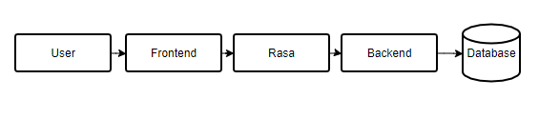
Block Diagram

Slide 12
Advantages
More visually pleasing
Less response time to user
Simple data set
Less processing time

Slide 13
Hardware and Software Requirements
H/W Configuration:
Processor - I5/Intel Processor
RAM - 8GB (min)
Hard Disk - 500 GB
S/W Configuration
Operating System : Windows 10
Server-side Script : Python 3.7.9
IDE : VS Code
Libraries Used : rasa
Framework : Django

Slide 14
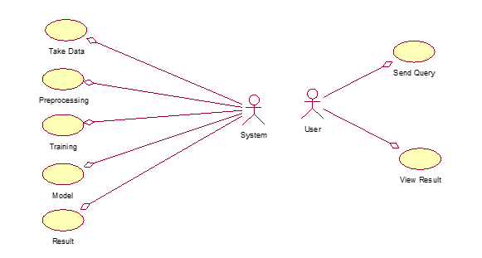
USE CASE DIAGRAM

Slide 15
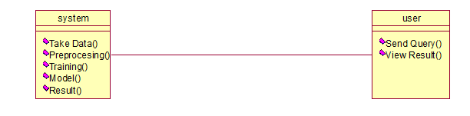
CLASS DIAGRAM

Slide 16
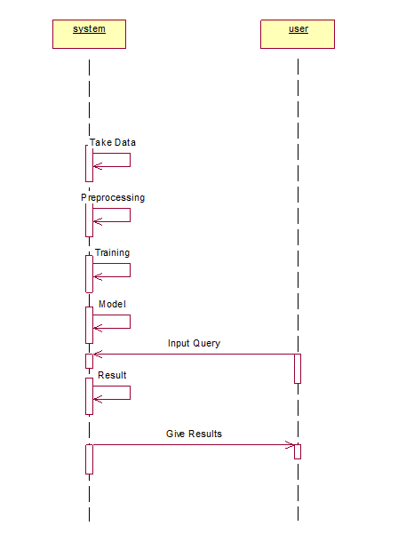
SEQUENCE DIAGRAM

Slide 17
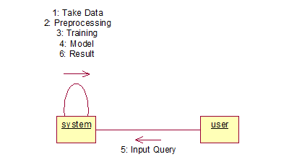
Collaboration Diagram

Slide 18

DEPLOYMENT DIAGRAM

Slide 19
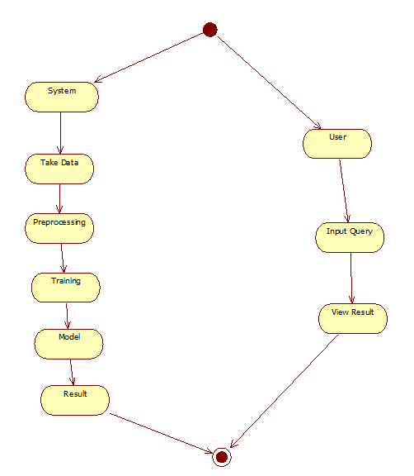
ACTIVITY DIAGRAM

Slide 20

Component diagram

